Slide 1

ECE 530 Cloud Computing
Ioannis Papapanagiotou
More on containers

Slide 2
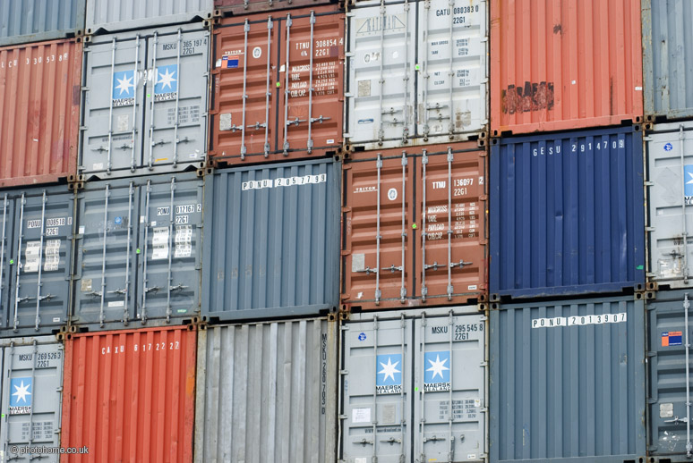
Why use containers?
Reduces build & deploy times
Cost control and granularity

Slide 3
Containers vs VMs
Container technology simplifies cloud portability.
Run same application in different environments
A container encapsulates applications and defines their interface with the surrounding system
In a virtual machine: a full OS install with the associated overhead of virtualized device drivers, etc.,
Containers use and share the OS and device drivers of the host.
Virtual machines have a full OS with its own memory management, device drivers, daemons, etc.
Containers share the host’s OS and are therefore lighter weight.

Slide 4
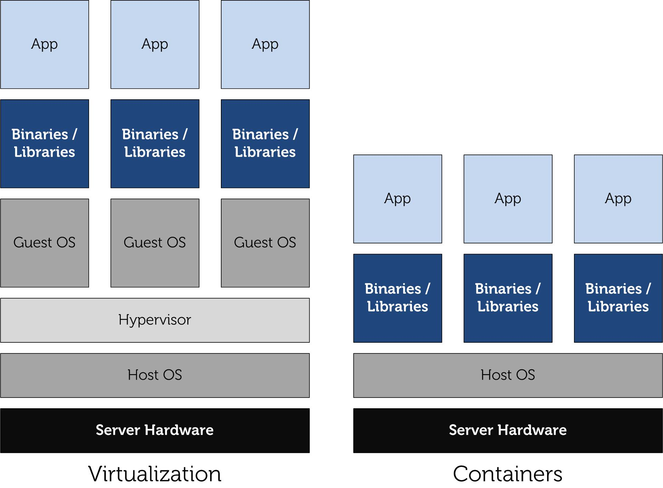
Virtual Machines vs Containers
Notes:
A container comprises an application and its dependencies. Containers serve to isolate processes which run in isolation in userspace on the host's operating system.
This differs significantly from traditional VMs. Traditional, hardware virtualization (e.g. VMWare, KVM, Xen, EC2) aims to create an entire virtual machine. Each virtualized application contains not only the application (which may only be 10's of MB) along with the binaries and libraries needed to run that application, and an entire Guest operating System (which may measure in 10s of GB).
Since all of the containers share the same operating system (and, where appropriate, binaries and libraries), they are significantly smaller than VMs, making it possible to store 100s of VMs on a physical host (versus a strictly limited number of VMs). In addition, since they utilize the host operating system, restarting a VM does not mean restarting or rebooting the operating system. Thus, containers are much more portable and much more efficient for many use cases.
With Docker Containers, the efficiencies are even greater. With a traditional VM, each application, each copy of an application, and each slight modification of an application requires creating an entirely new VM.
As shown above, a new application on a host need only have the application and its binaries/libraries. There is no need for a new guest operating system.
If you want to run several copies of the same application on a host, you do not even need to copy the shared binaries.

Slide 5
Containers can and can’t
Can
Get shell (i.e. ssh)
Own process space
Own network interface
Run as root
Install packages
Run services
…
Can’t
Use the host kernel
Boot a different OS
Have its own modules
Doesn’t need init as PID 1

Slide 6
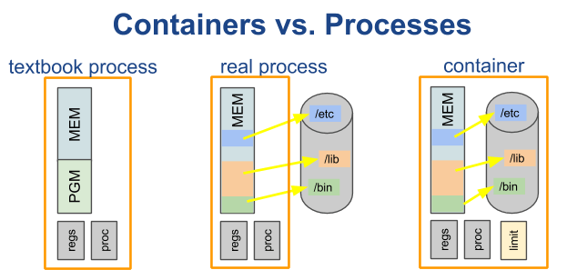
Containers vs Processes
Containers are processes with their full environment.
A computer science textbook will define a process as having its own address space, program, CPU state, and process table entry.
The program text is actually memory mapped from the filesystem into the process address space and often consists of dozens of shared libraries in addition to the program itself, thus all these files are really part of the process.

Slide 7
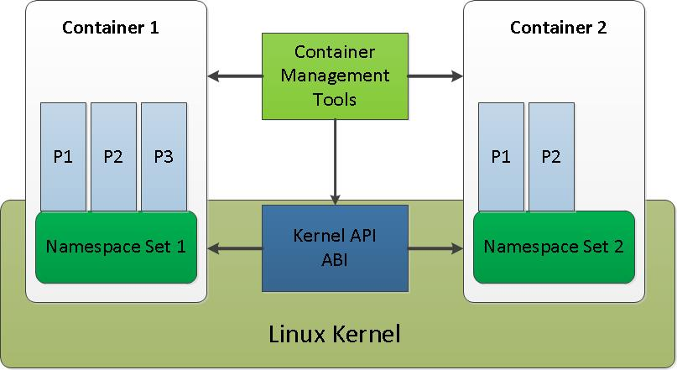
LinuX Containers (LXC)
Operation System level virtualization method for Linux
LXC (LinuX Containers) is an OS virtual for running isolated Linux systems (containers) on a single control host
Notes:
LXC (LinuX Containers) is an operating system–level virtualization method for running multiple isolated Linux systems (containers) on a single control host.
The Linux kernel comprises cgroups for resource isolation (CPU, memory, block I/O, network, etc.) that does not require starting any virtual machines. Cgroups also provides namespace isolation to completely isolate applications' view of the operating environment, including process trees, network, user ids and mounted file systems.

